Slide 1
Borrelia - a historic perspective with focus on test methods
Marie Kroun, MD - Odense, Denmark
http://LymeRICK.net
http://DanInfekt.dk

Slide 2
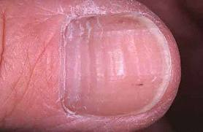
Lest we forget history …
Regarding clinical findings in Borrelia infection described 100+ years back in European literature
- I refer you to find my earlier presentation from Kassel 2006: http://lymerick.net/Bb-historyG.pdf
THIS PRESENTATION WILL ALSO BE PUT UP ON http://lymerick.net
- so you do not need to take any notes!
Historic things found since last lecture in 2006:
  5300 years ago Ötzi the ice-mummy, harbour Borrelia DNA
  – we will hear more about him Sunday, so I will just mention:
  He was probably in pain from arthritis / arthrosis, as he had tattoos made
  in skin over bone changes, perhaps used like acupuncture to relieve pain?)
  – and he had 3 Beau’s lines on a fingernail, indicating he had
  three fever episodes within the last few months of his life … Beau lines, from Google picture search, not Ötzi’s!
  HIPPOKRATES (and/or his successors)
  410 ante Christi / 2423 year ago circa - Hippocrates described relapsing fever as "ardent fever" i.e. burning fever (source: Felsenfeld 1971 JSTD 1999 reprint)
  - however other sources mention the term “ardent fever” was used more likely for malarial fever …
  (source: http://www.greekmedicine.net/pathology/Differentiation_of_Fever.html)
  "The cardinal signs and symptoms of an ardent fever are a high fever, extreme thirst; a full, rapid, bounding pulse; and profuse sweating. Because sustaining such a high, ardent fever is very exhausting to the organism, it should be brought down quickly and decisively with strong febrifuges. A high, ardent fever may be complicated or aggravated by toxicity and waste retention in the colon and bowels. In these cases, there may be constipation, an irritable bowel, nausea and vomiting, GI reflux symptoms, or a severe sore throat. Purging the bowels with an enema often brings relief.“
  …. This description could be of any acute infection, really …. BUT NEXT

Slide 3

Hippokrates - ca. 2400 years ago
On Weekly, Monthly and Quarterly cycles …
source: http://www.greekmedicine.net/pathology/Disease_Progression_and_Critical_Days.html
"The astrological conception or schema of critical days is patterned after the weekly quarters, or phases, of the monthly lunar cycle:
The first critical day is the day of onset, which often falls on a lunar quarter, but not always.
Subsequent critical days in the course of the illness fall at weekly intervals thereafter. If the illness had its onset on a Monday, for example, that initial Monday would be the first critical day, with the following Monday being the next critical day.
There can be up to four critical days in the progression of an acute illness, after which Greek Medicine classifies the disease as chronic.
On critical days, the illness makes its most decisive and important turns, or developments.
On the first critical day, the day of onset, the illness makes its initial appearance, presenting with its most salient or cardinal signs and symptoms. Subsequent critical days can mark decisive turns for the better, or even remissions; or, they can mark decisive turns for the worse.
The first judicial day comes on Day 3 of the illness, exactly two days after the first critical day, or day of onset. The full nature and scope of the illness unfolds completely, enabling the physician to judge fully its implications for the life and health of the patient.
Subsequent judicial days follow at weekly intervals thereafter, always two days after a critical day, for the entire course of the acute illness.
On these days, the physician can judge more fully the exact nature of the critical development that happened on the preceding critical day.
The first intercedental day comes on Day 5 of the illness, exactly four days after the first critical day, or day of onset. It presages what will happen on the following critical day. If things are going well on an intercedental day, even if it be the first one, chances are that the following critical day will mark a decisive turn for the better, or even a remission of the illness.
Conversely, if things are going badly on an intercedental day, the following critical day does not bode well, and may mark a turn for the worse.
In all illnesses, the astute physician takes careful note of the beginning, or day of onset, which is the most critical in determining the nature, course and duration of the disease.
Since subsequent critical days follow at one week intervals after the first, the Moon will always be in a sign of the same Modality as She was in at the day of onset, or the first critical day. If the Moon is in a Cardinal sign (Aries, Cancer, Libra, Capricorn) on the day of onset, the illness will most likely be acute, decisive and short term. If the Moon is in a Fixed sign (Taurus, Leo, Scorpio, Aquarius) on the day of onset, the illness will most likely be recalcitrant and entrenched, often going on to become chronic. If the Moon is in a Mutable sign (Gemini, Virgo, Sagittarius, Pisces) on the day of onset, the illness will tend to develop into something intermittent or recurring, that comes and goes. Conditions of environmental or allergic sensitivity are also favored.
Greek Medicine defines acute illnesses as those whose duration is a lunar month (four weeks) or less. Illnesses lasting longer than a month are defined as chronic. Chronic illnesses are under the dominion of the Sun and His annual solar cycle, with the critical periods occurring at three month seasonal intervals after the day of onset."
THIS ANCIENT DESCRIPTION OF CYCLICAL DISEASE ACTIVITY
ACTUALLY FIT THE PATTERN OF RELAPSING BORRELIA INFECTION WELL!
FUNNY! - I notice similar patterns, when I ask patients to keep a detailed symptom log with automatic curve drawing …
- though I have not put infectious cycles into a context with the lunar cycle, nor with the movements of the Moon into Astrological signs ;)

Slide 4
MICROBES - GOOD or BAD for US?
Many microbes live in us / on our surfaces, that we have thought are either helping* or are totally harmless bystanders, when present in ”normal” numbers, called our normal flora or commensals
* for instance K2-vitamin producing gut bacteria
The BALANCE / community of the normal microbial flora (microbiome) may, however, play an important role in keeping us healthy vs. causing “inflammation” symptoms in us?
Use of beneficial microbes (probiotics) or even ”fecal transplantation” of a healthy GUT FLORA, may not so surprising cure some chronic gut problems, Clostridium difficile, obstipation, diarrhoe
More surprising “connections” are gut flora may play a role in:
Obesity, diabetes (PDF).
Brain functions – development / behavior (PDF1, PDF2)
=>
FOOD FOR NEW THOUGHT / questions
– Microbial cause vs. consequence?
– what do a “MODERN LIFESTYLE” like eating much “factory prepared” FAST FOOD, usually with antimicrobial preservatives and “makeup” additives, “perfume”, colors, taste enhancers .. do to our microbiome / to us?
- what is behind all the E-numbers and what do we put in our mouth/gut and onto our skin?
(Japan: Soap containing wheat protein => wheat allergy resulting in life threatening severe anaphylactic reactions!)
– what do we really treat / change, when we are using ANTI-MICROBIAL drugs?

Slide 5
MICROBES and us - INFECTION?
ACUTE symptom causing infection (microbial pathogenicity / virulence / toxins?)
=> some microbes do apparently sometimes (but not always) cause SPECIFIC? (pathognomic) FOCAL? symptoms / signs / pathological changes normally associated with only ONE microbe spp.
- but beware, there are always TWO COMBATANTS in a WAR: MICROBEs vs. the HOST
( ~ susceptibility and immune defense reactions = inflammation)
MORE SYMPTOMS are CAUSED BY the HOST IMMUNE REACTIONS towards microbes
- than BY the MICROBEs actions?
Silent / subclinical infection (asymptomatic?)
=> infection may result in measurable immune response (raised antibodies), without the patients / doctors noticing any symptoms related to (having had) the infection; perhaps this is a matter of knowledge AND awareness?
Many infections cause the very same UNSPECIFIC signs/symptoms, i.e. HOST INFLAMMATION
- that doctors (patients too?) often give a quick tentative diagnosis:
”a virus”, ”allergy”, ”PMS”, ”hysteria”!?
Dormant / latent ~ (chronic) PERSISTENT infection
=> many microbes may create spore-like forms to survive under adverse condition, that can remain dormant for very long time, but which can wake up later, when the growth conditions become optimal … may begin to cause symptoms, long time (months to years) after the infectious agent was acquired?
– wellknown from SPIROCHETE infection, tertiary syphilis!
- TB may also reactivate many years after the primary inoculation, under HOST IMMUNE DEFECT!
Combination i.e. shifting between the 3 INFECTION phases above …
Lyme borreliosis: a relapsing fever-like disease? [Burgdorfer & Schwan 1991 PMID: 1947807]
Borrelia spp. => RELAPSING DISEASE ACTIVITY PATTERN - which may soon be revealed, IF the patient register all his/her symptoms with scores in a spreadsheet with automatic calculations and curve drawings, like my 2003 symptomdiary – which is my most important diagnostic tool - best of all it is TOTALLY FREE for any patient to use!!!
=> by timing MICROSCOPY perfectly to the (usually) cyclical RELAPSES,
we can detect SPIROCHETES in the blood by MICROSCOPY!

Slide 6
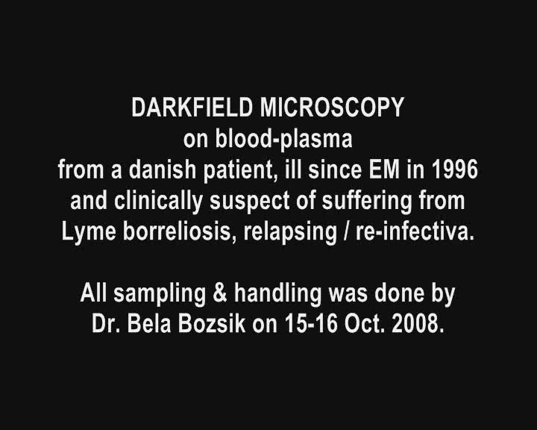
Blood microscopy: 0001-20081016 link online video

Slide 7
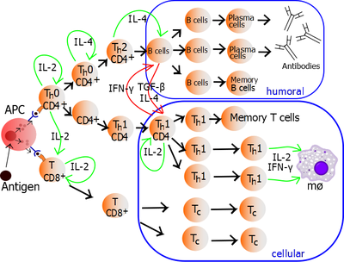
HOST reactions => symptoms of infection!
INFLAMMATION is divided into ACUTE - which occurs over seconds, minutes, hours, and days, and CHRONIC - which occurs over longer times, occurs over weeks, months and sometimes years!
Ex. TB, lepra, syphilis, borrelia spp. ..
Acute inflammation begins within seconds to minutes following the injury of tissues. The damage may be purely physical, or it may involve the activation of an immune response. Three main processes occur:
Increased blood flow due to dilation of blood vessels (arterioles) supplying the region
Increased permeability of the capillaries, allowing fluid and blood proteins to move into the interstitial spaces (Oedema)
Migration of neutrophils (and perhaps a few macrophages) out of the capillaries and venules and into interstitial spaces
Innate immune responses (primitive, first line of defense):
Various immune cells – macrophages, NK-cells, cytotoxic T-cells - are attracted to tissue damage by local inflammatory cells (dendritic cells) and release CYTOKINES plus activate the complement cascade ..
Reactions are all fast and furious, but quite UNSPECIFIC
- i.e. most microbes will elicit nearly the same symptoms!
Antigen presenting cells (APC)
=> start up development of antigen SPECIFIC immune response in specialized B-cells (ANTIBODIES) as well as T-cells … =>
Regulated by:
T-regs /T-suppressor (tolerance, self acceptance, prevention of autoimmunity)
T- helper cells → essential in B cell antibody class switching, in the activation and growth of cytotoxic T cells, and in maximizing bactericidal activity of phagocytes such as macrophages.
Th1 (cellular) vs. Th2 (humoral i.e. antibody)
Create ADAPTIVE, SPECIFIC reaction & IMMUNE MEMORY:
T_{h}1/T_{h}2 Model for helper T cells.
An antigen is ingested and processed by an APC. It presents fragments from it to T cells. The upper, T_{h}0, is a T helper cell. The fragment is presented to it by MHC2.^{[1]}
IFN-γ = interferon γ
TGF-β = transforming growth factor β
mø = macrophage
IL-2, interleukin 2
IL-4, interleukin 4
Source: http://en.wikipedia.org/wiki/T_helper_cell

Slide 8
Th1/Th2 balance - regulate ADAPTIVE immunity
Reduced IL-2, IL-4 => delayed/missing B-cell (ANTIBODY) activation!
Reduced IL-2, IFN => delayed/missing T- cellular activation!
  The specific T-cellular (macrophage, cytotoxic CD8+ cells) produce IFN, TGF, IL-10
  vs.
  the sspecific B-cell -> plasma cell -> ANTIBODY produce IL-4, IL-5, IL-6, IL-10, IL-13
  Human IL-10 (hIL-10) suppresses the proliferation and cytokine production of all T cells and the activity of macrophages, but continues to stimulate plasma cells, ensuring that antibody production still occurs.
  As such, hIL-10 is not believed to truly promote the T_{h}2 response in humans, but acts to prevent over-stimulation of helper T cells while still maximising the production of antibodies.
  [Source: http://en.wikipedia.org/wiki/T_helper_cell]
  But beware there is not full proof for the Th1/Th2 balance theory:
  2003 Kidd PDF: review 95 ref., quote ..
  “One theory of immune regulation involves homeostasis between T-helper 1 (Th1) and T-helper 2 (Th2) activity. The Th1/Th2 hypothesis arose from 1986 research suggesting mouse T-helper cells expressed differing cytokine patterns. This hypothesis was adapted to human immunity …
  Th2 cells drive the type-2 pathway (“humoral immunity”) and up-regulate antibody production to fight extracellular organisms; type 2 dominance is credited with tolerance of xenografts and of the fetus during pregnancy.
  Over-activation of either pattern can cause disease, and either pathway can down-regulate the other.
  But the hypothesis has major inconsistencies; human cytokine activities rarely fall into exclusive pro-Th1 or -Th2 patterns. The non-helper regulator T cells, or the antigen-presenting cells (APC), likely influence immunity in a manner comparable to Th1 and Th2 cells. Many diseases previously classified as Th1 or Th2 dominant fail to meet the set criteria….”

Slide 9
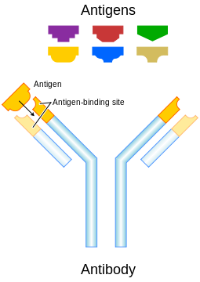
Antibody tests
Antibodies are produced by stimulated specific B-cells that have matured into PLASMA cells.
Each antibody binds to a specific antigen;
an interaction similar to a lock and key.
Source: http://en.wikipedia.org/wiki/Antibody
MOST Borrelia TESTs detect a variety of ANTIBODIES depending on KIT
– but we may encounter problems
First, getting a full serologic response up require a well functioning immune defense where cells (dentritic cells, macrophages) notice the foreign invasion, and reacts as APC .. Starting the chain, as it is supposed to ...
But Borrelia is a MASTER in DISGUISE … Besides:
A POSITIVE SEROLOGY just tell about ”previous exposure”, is not PROOF of CURRENT ACTIVE infection! - except when both IgM+ and IgG+, it is interpreted as recent infection (and usually treated).
False positive result should NOT be a problem, when test cut-off is set to give SPECIFICITY >95%
- and HEALTHY PERSONs DON’T HAVE RECURRENT BORRELIA RELAPSE ACTIVITY!
False negative IS HOWEVER A BIG PROBLEM FOR THE BORRELIA INFECTED!
– as it leads to INCORRECT or NO DIAGNOSIS and DENIAL / DELAY of TREATMENT
Causes:
Impaired antibody formation due to immune inhibition (next slides)
Too much difference between the patients BORRELIA’s antigen(s) and the SELECTED TEST antigen(s)
(BORRELIA spp. great diversity, antigen variation, adaptation, alternative forms - more on this later)
During CURRENT ACTIVITY antigens bind antibodies in immune complexes => activate complement & cytokine cascade; most of IC probably precipitate in small vessels => vasculitis (this is the typical micro-pathologic change)
- and there may not be any surplus antibody free to bind to test antigen, even if we were lucky to get a good match!
Technical reasons

Slide 10
TICK SALIVA
- facilitates prolonged tick feeding AND transmission of infections!
– contains: Anesthetic, Anticoagulant & IMMUNE DEPRESSING FACTORS
PDF Ribeiro 1985: A. Antihemostatic, anti-inflammatory, and immunosuppressive properties of the saliva of a tick, Ixodes dammini [I. scapularis].
”We showed the presence of prostaglandin E2 (PGE2) by bioassay and radioimmunoassay. This saliva inhibited interleukin 2 [IL-2] production by T cell hybridomas, an activity consistent with that of PGE2.
1999 Ferreira PMC: Successive tick infestations selectively promote a T-helper 2 cytokine profile in mice
Rhipicephalus sanguineus tick saliva stimulates transforming growth factor-β (TGF-β), and reduces interleukin-12 (IL-12) secretion by cells from normal C3H/HeJ mice.
Moreover, murine lymph node cells harvested 6 days after the fourth infestation with ticks presented an 82·4% decrease in their proliferative response to concanavalin A (Con A) compared with the response of control cells. In addition, lymph node cells cultured in the presence of Con A showed a T-helper 2-type (Th2-type) cytokine profile, represented by augmented IL-4 and IL-10 and TGF-β. On the other hand, the IL-2, interferon-γ (IFN-γ) and IL-12 synthesis was significantly inhibited. These results indicate that ticks may modulate the host’s immune response through saliva injection. Considering that C3H/HeJ mice develop no protective immunity to R. sanguineus infestation, our results suggest that tick-induced Th2-type cytokines and a decreased proliferative response probably lead the host to a susceptible state to both tick and tick-transmitted pathogens.
2002 Anguita PDF: Salp15, an Ixodes scapularis Salivary Protein, Inhibits CD4+ T Cell Activation
2011 Schuijt PDF: A tick mannose-binding lectin inhibits the vertebrate complement cascade to enhance transmission of the Lyme disease agent .. “(P8, TSLPI)” ..
2011 Marchal PDF: Antialarmin Effect of Tick Saliva during the Transmission of Lyme Disease
“Tick saliva has potent immunomodulatory properties. In arthropod-borne diseases, this effect is largely used by microorganisms to increase their pathogenicity and to evade host immune responses. … tick salivary gland extract and a tick saliva protein, Salp15, inhibit in vitro keratinocyte inflammation induced by Borrelia burgdorferi sensu stricto or by the major outer surface lipoprotein of Borrelia, OspC. ... We conclude that tick saliva affects the chemotactic properties of chemokines and AMPs on immune cells and has an antialarmin effect on human primary keratinocytes.
Alarmins are mediators that mobilize and activate antigen-presenting cells. Inhibition of cutaneous innate immunity and of the migration of immune cells to the site of the tick bite ensures a favorable environment for Borrelia. The bacterium can then multiply locally and, subsequently, disseminate to the target organs, including joints, heart, and the central nervous system.”
2012 Lieskovska PDF: Tick saliva suppresses IFN signaling in dendritic cells upon Borrelia afzelii infection
“… thus facilitating the transmission of tick-borne pathogens.”
There are many MORE PAPERS ON HOW TICK SALIVA enhances the transmission of microbes and delay the mammal host immune responses; I selected a few papers with OA-PDF to illustrate some known factors in the host-vector relation with host immune-modulating properties!

Slide 11
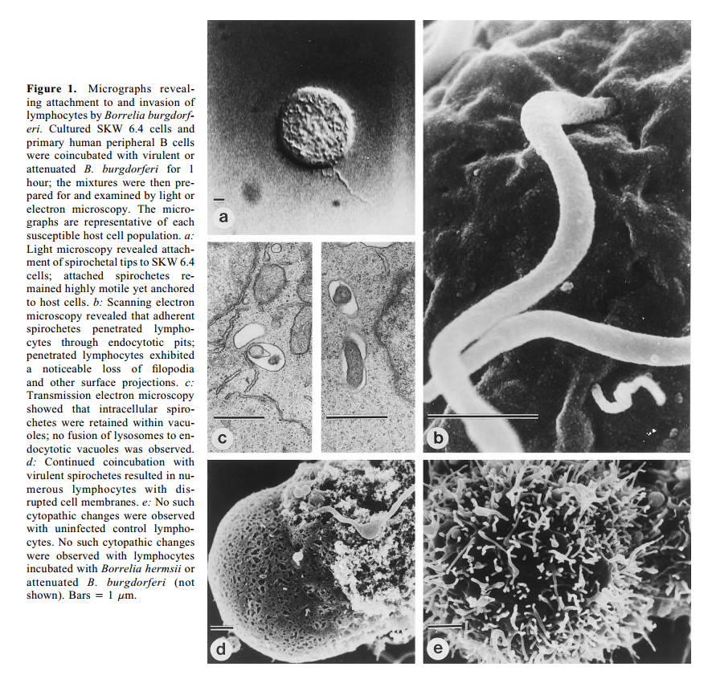
Immune depression by Borrelia burgdorferi
There are many reasons for host immune depression, toxin exposure (heavy metals, microbial toxins and more), co-infections with tick-borne bacteria that attack white blood cells directly, like Anasplasma, Ehrlichia, Q-fever, and/or vira like HIV, CMV, EBV?
- to name a few possible causes for decreased immune response ..
WE CAN NOT EXPECT ALL INFECTED WILL ALWAYS REACT OPTIMALLY IN THE SAME WAY – ANTIBODY TESTs MAY FAIL!
BORRELIA attack host immune cells directed towards Borrelia antigens:
1997 Invasion and cytopathic killing of human lymphocytes by spirochetes causing Lyme disease. →
Dorward DW et al. Clin Infect Dis 1997 Jul; 25 Suppl 1: S2-8. PDF
"We found that B. burgdorferi actively attaches to, invades, and kills human B and T lymphocytes. Signiﬁcant killing began within 1 hour of mixing. .. peaked after 1 day .. Cytopathic effects varied with respect to host cell lineage and the species, viability, and degree of attenuation of the spirochetes. Both spirochetal virulence and lymphocytic susceptibility could be phenotypically selected, thus indicating that both bacterial and host cell factors contribute to such interactions.
... We could find no previous reports of aggressive, invasive cytopathology in lymphocytes caused by [other] bacteria.
... the ability to invade lymphocytes could provide an effective niche for avoiding immune detection and clearance. ... humoral responses are typically delayed in patients. In vitro spirochete-leucocyte interactions may provide an effective model for understanding the delayed immune response in humans when they are infected by Lyme disease spirochetes."
2003 Lymphocyte apoptosis co-cultured with Borrelia burgdorferi.
Perticarari S et al. Microb Pathog. 2003 Oct;35(4):139-45. PMID: 12946326
"... investigated whether the in vitro co-cultivation of lymphocytes with spirochetes would induce apoptosis in human lymphocytes. Peripheral blood mononuclear cell were mixed with various ratio of cell/spirochetes ... data suggest that spirochetes were able to induce apoptosis on lymphocytes; the phenomenon appears associated with number of spirochetes, incubation time and the release of IL-10 in co-cultures. Moreover apoptosis was probably Fas-mediated and the cells involved were prevalently CD4.“
IF all the B-memory cells directed towards Borrelia burgdorferi (Bb) is eradicated by Borrelia self
- then AWAY goes forever the Borrelia specific antibodies?
- and our serology test will fail to detect Bb infection!

Slide 12
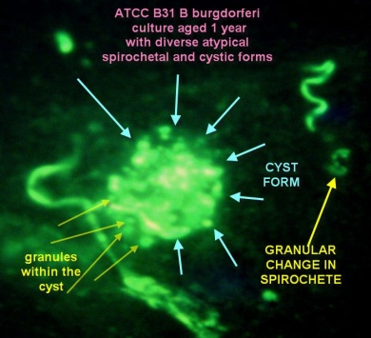
TESTs for INFECTION
* CD57-NK-cell (not CD57- T cells) fraction, measured by flowcytometry, is often low in Borrelia infection > 1 year
- but other chronic infections could give same?
Prognosis is best if number of CD57-NK-cells increase during anti-microbial treatment!
INNATE IMMUNE REACTION (non-specific, no memory)
Complement cascade reactions (C3a, C4a split products)
Immune cells attack directly: NK-cells*
.. cytotoxic T-cells, monocyte / macrophage phagocytosis
– act as antigen presenting cells (APC) ..
Cytokines pro-inflammatory / anti-inflammatory balance
…. Are rarely being measured, but TNF, IL-1b, IL-2, IL-6 elevated in pro-inflammation!
Acute phase reactants like CRP usually normal or only low (~”virus”-level) in chronic infection!
INDIRECT METHODs - measure immune reaction
B-cellular response – antibody test
type of antibodies (serum + spinal fluid, joint fluid as index): IgM, IgG, (IgA)
Methods IFA, ELISA, immunoblot (WB) … is usually, if not always measured!
T-cellular response – lymphocyte stimulation test (LTT, next slide)
measure cytokine production of T-cells after short antigen stimulation
…. increased use during the last 5+ years
DIRECT METHODs - detection of microbes (or fractions) in material harvested from a patient
Microscopy (the simplest, oldest microbiology test!) aided by BORRELIA specific DIRECT immune stain - DFA, not to be confused with IFA! =>
1941 Coons AH The development of immunohistochemistry. Ann N Y Acad Sci. 1971 Jun 21;177:5-9.
Culture – still the GOLDEN STANDARD (Sapi /Adv. lab. 2013 improved culture method)
- above have been doomed too difficult / too slow / too expensive by laboratories
(reason perhaps being that not much money can be earned in using non-patentable old methods!)
PCR
NOTE: Direct methods are not used as “stand alone”, but are used “in concert” !
Borrowed from
Alan MacDonald 1985

Slide 13
Lymfocyttransformations test (LTT)
measure the amount of INTERFERON (IFN)
- being produced by already sensitized T-cells (memory cells) isolated from patients buffy-coat, then stimulated with relevant microbial antigens.
2012 Von Baehr et al. PDF:
”.. a lymphocyte transformation test (LTT) using lysate antigens of Borrelia burgdorferi sensu stricto, Borrelia afzelii and Borrelia garinii and recombinant OspC was developed and validated through investigations of seronegative and seropositive healthy individuals as well as of seropositive patients with clinically manifested borreliosis. The sensitivity of the LTT in clinical borreliosis before antibiotic treatment was determined as 89,4% while the specificity was 98,7%. …
Following antibiotic treatment, the LTT became negative or borderline in patients with early manifestations of borreliosis, whereas in patients with late symptoms, it showed a regression while still remaining positive. Therefore, we propose the follow-up monitoring of disseminated Borrelia infections as the main indication for the Borrelia-LTT.”
1993 Haüpl et al. Persistence of Borrelia burgdorferi in ligamentous tissue from a patient with chronic Lyme borreliosis. Arthritis Rheum 1993 Nov; 36(11): 1621-6 PMID: 8240439
First time LTT was used for Borrelia burgdorferi? - in a scholarly well examined case; an extensive quote from this instructive article is in my list: http://lymerick.net/persistent-borreliosis.html
The patient had repeatedly good relief of all symptoms during antibiotic treatment, first treatment was doxycycline for 6 weeks, but the patient experienced more relapses occurring when not in antibiotic treatment; eyes, heart and joint/ligament was affected; the patient developed a trigger finger that needed operation.
That lead ultimately to tests documenting the persistence of Borrelia by isolation, CULTURE is still the gold standard test! – detecting a Borrelia strain with antigens and genetic close resemblance to B. afzelii.
The patient was initially seropositive, but turned sero-negative after the first treatment, still sero-negative at time of positive culture, even when the patients own isolated strain was used as test antigen!
– however a positive reaction was detected in the patients T-cells on stimulation with the patients Borrelia strain!
Persistent Borrelia infection was also documented by positive PCR and by electron microscopy of the ligamentous tissue (after culture).

Slide 14
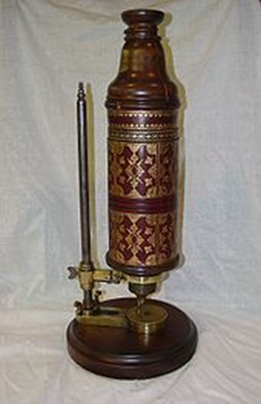
There is nothing NEW under the sun /microscope …
BUT when we begin looking at IT in high magnification via a microscope, we might discover something that we did not know existed before we looked …
TIMELINE (circa):
1300 concave and convex lenses for spectacles
1595 the first primitive microscopes were constructed by Hans and Zacharias Jansen, but they did not descibe any findings with their instrument.
1665 Robert Hooke (1638-1703)
Published Micrographia, the first book on microscopy by a scientist, which contain descriptions of various biological specimens and drawings made by Hooke himself, of louse and flea, the compound eye of a fly, seeds and plant sections, but not of microbes.
Hooke coined the term cell for describing biological organisms, the term being suggested by the resemblance of plant cells to monks' cells.

Slide 15


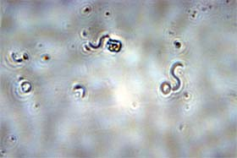
The father of microbiology:
Antonie van Leeuwenhoek (1632–1723)
Van Leeuwenhoek was a Dutch draper with no formal scientific training, who became fascinated by the magnifying glasses used to count the threads in cloth.
He learned how to grind and polish lenses and developed such techniques further. Van Leeuwenhoek made more than 500 simple microscopes, each containing a single, tiny convex lens that could resolve detail as small as 1 micrometre.
He became extremely skilled in dissecting and mounting specimens and, although his microscopes were laborious to use, he was the first to describe sperm cells and life in droplets of water in the form of bacteria and protozoa. From 1673 onwards, he communicated his observations to the Royal Society in a series of letters, eventually being recognized for his careful observations when he was elected a member of the Royal Society in 1680.
Sources:
Wikipedia
Brian J Ford:
http://www.brianjford.com/a-avl01.htm
Spirillum (fresh water)
http://www.brianjford.com/avspec11.jpg

Slide 16

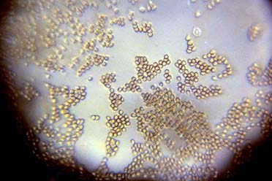
http://www.brianjford.com/bjford.htm
Brain Ford http://www.brianjford.com/a-avl01.htm - write about Leeuwenhoek’s work and specimens
"The most compelling version of Leeuwenhoek's introduction to the microscopical universe is contained in the compelling biography of Clifford Dobell, whose widow Monica has broadened and deepened my understanding of the published account [9].
Leeuwenhoek described microorganisms including algae, protozoa, rotifera and bacteria in fresh water samples and recorded that:
"The motion of most of them in the water was so swift, and so various, upwards, downwards, and roundabout, that I admit I could not but wonder at it. I judge that some of these little creatures [~animalcules] were above a thousand times smaller than the smallest ones which I have hitherto seen on the rind of cheese, wheaten flour, mold and the like".
Similarly, from his letter on pepper-water described by R. T. Gunter's Early Science in Oxford, (1931) VIII, 299:
"Some of these are so exceedingly small that millions of millions might be contained in a single drop of water. I was much surprized at this wonderful spectacle, having never seen any living creature comparable to those for smallness; nor could I indeed imagine that nature had afforded instances of so exceedingly minute animal proportions".
“. . my work, which I've done for a long time, was not pursued in order to gain the praise I now enjoy, but chiefly from a craving after knowledge, which I notice resides in me more than in most other men. And therewithal, whenever I found out anything remarkable, I have thought it my duty to put down my discovery on paper, so that all ingenious people might be informed thereof.
Antony van Leeuwenhoek. Letter of June 12, 1716
http://www.brianjford.com/wavrbcs.jpg

Slide 17
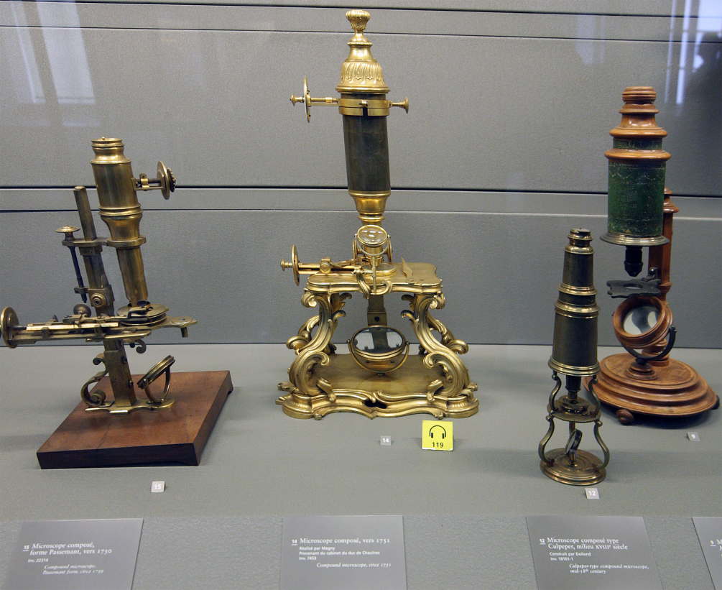
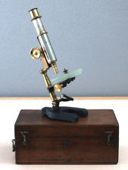
Antique Microscopes
are sometimes put up for sale
on eBay:
http://en.wikipedia.org/wiki/Microscope
1800 Century microscopes - Musée des Arts et Métiers, Paris
Our first knowledge about microbes as cause of illnesses was brought to us by people looking into such simple microscopes! Read their original papers and you will be astounded of what they saw and described.
MICROSCOPES are still very usefull tools, and have evolved, better today, especially CAMERAs, and stain methods!
For sale on eBay (25-03-2013) (link)
PAUL WAECHTER BERLIN ANTIQUE BRASS "TRICHINEN MIKROSKOP" MICROSCOPE STATIV VIII. Patented in 1880 W/Rotating Compressorium - circa 1885

Slide 18
Many great discoveries
- were made with the old monocular microscopes:
1675 Leeuwenhook – father of microbiology – describing “Animalcules”
1833 Ehrenberg invented the name Spirochaeta for the organism discovered and named by him: Spirochaeta plicatilis. Source: 1911 Bosanquet
1848 Virchow (1821-1902) - father of pathology.
.. clinical observation, animal experimentation (to determine causes of diseases and the effects of drugs) and pathological anatomy, particularly at the microscopic level, were the basic principles of investigation in medical sciences. Virchow also developed a standard method of autopsy procedure …
1857 Béchamp (1816-1908) – Microzymas
1864 Davaine (1812-1882) - „Bacteridien“ Bacillus anthracis, cause of anthrax. (Milzbrand, Maladie du charbon)
1868, publ. 1873 Obermeier (1843-1873) - Sp. Obermeíerii (or Protomycetum recurrentis, Spirochaeta recurrentis ..) - now called Borrelia recurrentis
1872 Cohn (1828-1898) His classification of bacteria into four groups based on shape (sphericals, short rods, threads, and spirals) is still in use today.
Among other things Cohn is remembered for being the first to show that Bacillus can change from a vegetative state to an endospore state when subjected to an environment deleterious to the vegetative state.

Slide 19
More important discoveries ..
1882 Koch (1843-1910) – famous for isolating Tuberculosis bacillus (1882), Vibrio cholerae (1883), Bacillus anthracis (1877), and for his development of Koch's postulates.^{[1]}
1. microorganism must be found in abundance in all organisms suffering from the disease, but should not be found in healthy organisms. [some organism may not be abundant]
2. microorganism must be isolated from a diseased organism and grown in pure culture.
[we know now that we can not grow all disease causing germs in vitro!]
3. cultured microorganism should cause disease when introduced into a healthy organism.
[we know now that disease depends not only on microbe, but very much also on host factors, such as susceptibility, immune reactions!]
4. microorganism must be reisolated from the inoculated, diseased experimental host and identified as being identical to the original specific causative agent. [we know now, that some microbes change antigens and appearance so it may look different when testing for it!]
Suggested ADDITIONAL criteria by Breitschwerdt et al. 2013 PMID: 23453733
A microbial agent must be considered cause of disease, when it can be detected by any direct method in 3 animals with similar disease/symptoms and/or cause similar pathologic changes ..
Other tick- or louse-borne infections …
1885-88 Babes (Romania) "Haematococcus bovis“ => piroplasma babesia
1893 Smith & Kilborne - found Texas cattle fever to be tickborne!
1902 Wilson & Chowning - investigated "spotted fever" and also found an erythrocyt parasite "piroplasma hominis“
1905 Schaudinn and Hoffmann – found the agent of syphilis, Spirochaeta pallida (also known as Treponema pallidum). .. saw with the ordinary lenses of the microscope in the living, moving germ, what dozens can scarcely see today with the germ glued to the spot and with all the aid of stains and dark-field apparatus. …the germ was removed from a papula in the vulva of a patient with secondary syphilis.
1905 Barton Thompson (1870?-1950) – discoved Bartonella bacilliformis as cause of Oroya fever i Peru
Fourteen patients with anemia and fever were studied by Barton. He discovered bacillus on their red blood cells. …
Now we know several Bartonella spp.
1906 Ricketts (1871-1910) – pathologist, studied Rocky Mountain spotted fever (Rickettsia)
Paper Memorial
1906 Borrel (1867 - 1936) – [C. R. Soc. de Biol., 1906, LX, 138] On Sp gallinarum or Sp anserina , later named Borrelia anserina - gave name to the genus Borrelia …

Slide 20
Spirochete also spelled spirochaete (order Spirochaetales)
Brachyspiraceae (intestinal spirochetes)
  Brachyspira pilosicoli , Brachyspira aalborgi – may cause diarrhea
  http://www.ncbi.nlm.nih.gov/pmc/articles/PMC193795/
Leptospiraceae
  Leptospira, together with the genera Leptonema and Turneria. The genus Leptospira is divided into 20 species based on DNA hybridization studies. / 200 serotypes; some are very pathogenic, others opportunistic, other are nonpathogenic
Spirochaetaceae)
Treponemes
Syphilis (Treponema pallidum pallidum)
Yaws (Treponema pallidum pertenue)
Bejel (Treponema pallidum endemicum)
Pinta (Treponema pallidum carateum)
Borrelia spp. on the following slides

Slide 21
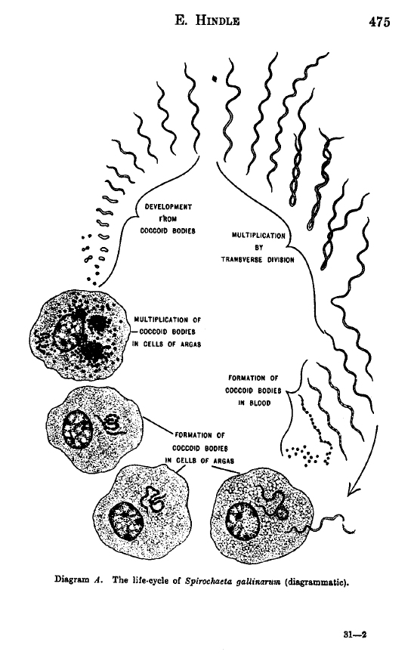
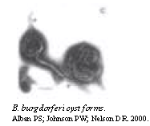
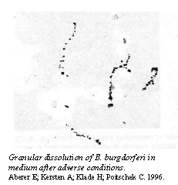
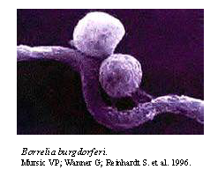
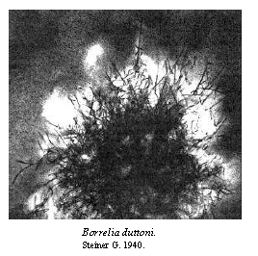
Spirochetes – alternative life forms
100 years pictorial - spirochetes undergo quick transformation to cyst form / GRANULES ~ ROUND FORMs under adverse conditions for the spirochete form ..
ROUND FORMs have NO FLAGELLA on surface
=> DO NOT STIMULATE FLAGELLA-antibodies!
1998 Brorson about Borrelia burgdorferi
- reversion from cyst to spirochete form in vitro:
The biological activity of the cystic forms was confirmed by the step by step development to normal mobile spirochetes in BSK-H medium, and also indicated by the presence of RNA in 5-week-old cysts due to red-orange staining with acridine orange (pH 6.4) (Fig. 4b). … The creation of as many as five spirochetes from each cyst may explain why the generation time was shorter for production of mobile spirochetes from cysts compared to that for normal mobile spirochetes cultivated conventionally. … Whether cysts are converted to normal mobile spirochetes or not depends strongly on the growth medium used, and possibly also the generation time.
It seems as though normal mobile spirochetes are developed from the dense core structures or the cyst by being "fed" with core substances as the "infant-spirochete" protrudes from the cyst. ..
Old cystic forms of B. burgdorferi require prolonged cultivation to convert to normal mobile spirochetes (4 weeks as opposed to 9 days for young cysts).
THE TIMELY PATTERN seen IN VITRO is very well CONSISTENT WITH THE CLINICAL RELAPSE PATTERNs, when patients do my SYMPTOMDIARY!
+ MICROSCOPY, timed to day 1 at start of a new weekly flare => SPIROCHETES DETECTED BY MICROSCOPY!
PERSISTENT SPIROCHETOSIS DEMONSTRATED!
2001 Conversion of Borrelia garinii cystic forms to motile spirochetes in vivo. Gruntar et al. APMISMay;109(5):383-8. PMID: 11478686
Varying effect of antibiotics on different forms:
2010 Sapi et al. (PDF) Banderol, Samento, Doxycyclin
2011 Sapi et al. PDF: Comp. more conventional antibiotics

Slide 22
Spirochetes - Borrelia spp.
Good source for early literature on spirochaetes:
1911 Bosanquet (1866-1941. Spirochaetes, a review of recent work with some original observations.
(open access: PDF more formats)
PREFACE: ”Having had occasion to study the literature bearing on the subject of Spirochaetes in connection with observations which I made on two species of this genus. I was struck with the voluminous and at the same time scattered mass of papers to which reference had to be made. I therefore thought it might be useful to others if, instead of merely laying aside the abstracts which I had made, I put them together in the form of a small book. .. I have confined myself to very brief descriptions of the various organisms and of the methods employed for examining them, as those who are interested in particular species or methods will in any case refer to the original papers. Their task will, I hope, be facilitated by the bibliography here appended. This is by no means exhaustive, as many papers are published in unattainable periodicals, and I have included comparatively few references to articles which I have not myself consulted either in the original or in abstract. I hope, however, that the more important papers are included….”
1907 Schwellengrebel (on Borrelia).
Compt. rend. Societe de Biologie, 1907, LXII, 213.
Annales de I'Inst. Pasteur, 1907, XXI, 448, 562. 907
1971 Felsenfeld book:
BORRELIA: Strains, Vectors, Human and Animal Borreliosis.
Reprinted in J Spir Tickborne Dis 1999
Review on human borreliosis from many sources and places ..
”Relapsing fever (borreliosis) may appear either in louse-borne epidemics or in sporadic tick-borne instances. The disease is characterized by recurring attacks of fever, usually of decreasing intensity and duration. Relapsing fever, however, may be of sufficient intensity as to terminate in death. The disease has been named "febris recurrens,” “recurrent fever,” “famine fever, ”spirillum fever,” “spirochetal fever,” “vagabond fever” (Spain), "fowl nest fever” (China),"gharib gez" (Iran), “Giesinger's bilious typhoid” (Egypt), “carapata", (Africa), "kimputu,” “gorgoya” (South America), “tick fever.” It has also been given other epitheton ornans – is taken from local picturesque descriptive designations and from more or less fortunate combinations of greco-neo-latin terms. The generally accepted name, however, is relapsing fever and, in countries adhering to Latin nomenclature. “febris recurrens". ”
SO THERE WERE ALREADY in 1911 MANY PAPERS on the subject of spirochetes / Borreliae spp. with many names - and many more in 1971
- number of publications have INCREASED EVER SINCE
- with the nomenclature of spirochetes sometimes shifting names!
CONFUSION – were many spp. they thought were different spp., really the same, but displaying varying morphology?
- which old spirochete names, corresponds to the names we use nowadays?
- listed in for instance: NCBI Taxonomy browser
Could some of the old descriptions of spirochetes found in various TICKs (Ornithodoros spp.) have been what we later associate with ”Lyme disease”?

Slide 23
Borrelia spp. - Diversity, antigen variation, adaptation to its current hosts immune reaction
1971 Felsenfeld’s book: BORRELIA: Strains, Vectors, Human and Animal Borreliosis.
Reprinted in J Spir Tickborne Dis 1999
(Felsenfeld knew much about borrelia, but got one thing wrong, his dismissal of the “granulation” process as a way Borrelia survive, which was in line with Burgdorfer at the time, but Willy Burgdorfer acknowledged he had been wrong in his 1999 keynote conference lecture!)
PREFACE: “One is amazed at the confused nomenclature and the mass of misinformation concerning the transmission and vectors (some of which has managed to creep into even respectable textbooks). The considerable variations in the clinical picture during various outbreaks and in widely separated localities, and the unusual immunologic conditions that accompany the infection should he emphasized so that the medical profession can be alerted should an outbreak occur in this country.
The genus Borrelia that causes human relapsing fever includes some species that are of interest to the dentist (Borrelia vincentii), and to the veterinarian (B. anserina, B. theileri). Borrelia infections appear in man as relapsing fever and in animals as so-called fowl spirochetosis or tick-transmitted spirochetosis in cattle, which are clinically defined entities. This monograph deals principally with human relapsing fever and fowl spirochetosis, while exploring other conditions in which borreliae may play a role. The discussion of the borreliae and their vectors, the pathology caused by them, and other features will be presented in separate chapters discussing borreliosis as human relapsing fever, cattle and fowl disease, and Vincent's angina, respectively. Each of these chapters will deal separately with the species of Borrelia involved, and with the consequences of the infection. Borreliae that have been isolated from vectors only, and not front man or animals, will also be enumerated.”
All around the World .. I focus on mentioning mainly Europe .. Several epidemics of louse-borne relapsing fever: 2400 years ago Hippocrates .. ”sweating sickness” England 1485-1551, England & Ireland 1739-1741, (Rutty), Edinburgh 1834-1848. The designation ”Relapsing fever” was first used by Craigie in 1843. Scandinavia 1788 (Russia to Sweden), Germany (Berlin, Otto Obermeier) 1867-68 (found Borrelia recurrentis), Ireland 1868-1871 .. WW1
Later improved hygiene has kept Western Europe free from large relapsing fever epidemics ..
”The study of tick-borne or endemic borreliosis went through the same phase as the rest of microbiology, when the major interest apparently was to discover new species and strains.
Borreliosis is a dynamic condition, a cyclic disease characterized by a cyclic causative agent.
No wonder that great numbers of species have been proposed on the basis of minor or not fully understood strain variations and mutations, incomplete knowledge of the vector, and epidemiologic observations that were not extended far enough “longitudinally” and “laterally.”

Slide 24
Felsenfeld 1971 cont. 1
Borreliae have been designated by a number of different names in the past such as Protomycetum, Spirochaeta, Spirocheta, Spirillum, Spironema, Treponema, etc. The European literature, including that of the USSR still uses Spirochaeta in certain publications, whereas this term should be reserved only for free-living forms.
The identification of Borrelia species according to the usual bacteriologic characteristics is difficult if not impossible. The organisms are not easily cultured, and their antigenic phase variations during relapses, which is one of the principal features of the agent, often preclude serologic diagnosis. Animal responses may be variable. The morphologic characteristics of all recognized species are about the same .. and often depend on the fixative and staining method employed…
Other means of classification had to be sought and were found in the agent-vector relationship. … The names of the borreliae are closely linked with those of their vectors, principally because the agent-vector specificity is strong in borreliae.
Classifying Borrelia serologically is a very difficult task. Jancó_ compared the characteristics of strains collected from different relapses in the same patient, and found that cross-immunologic phenomena are not the rule.
This led to recognition of the fact that borreliae undergo phase variation and develop antigenic variations during subsequent attacks by the same organism in man and animals. Beck_ saw similar results using protection test by inoculating animals previously infected with homologous strains collected from subsequent attacks. Several investigators_ reviewed this problem. Russell_ attempted to establish “serotypes (phases) and designated them by the use of capital letters. Experimenting with large West African rats (Cricetomys gambianus), she found that only serotypes A and B conferred lifelong immunity. In later investigations Russell_ found that the serotype of the variant strain recovered from a later relapse in the rat that had been inoculated with the variant will be serologically identical to the organism isolated from the patient during the attack that followed the relapse from which the Borrelia was originally isolated. She concluded that Borrelia can adapt itself repeatedly to the antibodies of the animal although the number of readaptations is limited.
Ashbel_ studied 17 strains of B. persica in 110 guinea pigs which are strongly susceptible to this Borrelia strain. He found that immunologic variants occur more often in man than in animals. Serologic variants have been observed also in monkeys, and in one tick vector. The original Borrelia strain did not protect against infection with relapse strains in some instances. However, relapses occurred with and without the development of variants.
Paper contain good tips on isolation, culture and staining methods …

Slide 25
Felsenfeld 1971 cont. 2
Cunningham et al. _ experimented on squirrels (Sciurus palmaris) and monkeys.
They described 9 phases and labeled them according to their sequence in consecutive attacks, from A to I. Phase A from the first attack, B from the first relapse, and D and E from the second relapse were complementary to each other. Phase C from a second attack in a mixed infection, and D and E from the second relapse were reIated to B; phase G from a second attack was related to phase A. Phase F was rare, whereas, H and I developed in prolonged relapses, when phase B was at a low ebb. In man mostly A and B were observed, with C, F, and G occurring less often, and with a tendency to revert to A or B.
This study demonstrated the intricacies of the serologic structure as well as the coexistence of several variants.
Tick-borne borreliae appear to undergo more variation than louse-borne species.
Serologic and other studies of borreliae are further impeded by the occurrence of partly related, partly dissimilar strains in the same locality or in nearby localities.
Granules still present in old cultures were infective for mice.
It is possible that some or all of these strains were tick-borne, rather than louse-borne. Nicolle and Anderson _, working in Tunisia, believed that louse-borne borrelia can be transferred to ticks. ….
Iran 1945-46 Head lice were found on 88% of patients and Borrelia recurrentis was isolated from some of the head lice!
A number of arthropods other than lice and ticks have been considered as possible vectors of human relapsing fever.
Bedbugs (Cimex lectularis) are the first in importance among these.
RosenhoIz_ surveyed the literature and in his own experiments found B. duttonii in the gut of bedbugs for 5 days after feeding, but borreliae did not find their way into the celomic cavity in all the bugs that were fed. B duttonii survived for about 2 months in those that were successfully infested. Chung_ studying an outbreak of epidemic relapsing fever in an orphanage in Peiping, stated that bedbugs may acquire B recurrentis, but the organism vanishes from their blood in one day. Furthermore, Chung and Feng_ concluded from the results of their experiments that bedbugs, like lice, have to be crushed to transmit the infection. Francis_ succeeded in transmitting B. turicatae by C. lectularis…
Weyer and Moser_ were able to preserve B. recurrentis and B. hispanica in frozen bedbugs.
Infection may be acquired .. through mucous membranes .. Human urine, and prostatic fluid [and ] ..menstrual blood also carry borrelia .. Infection through the conjunctiva has produced disease in 8 days
Laboratory infections have been acquired through squirting blood into the nose .. And eye ..see Borrelia burgdorferi : http://lymerick.net/Transmission-Bb-contact.htm
The interference phenomenon (serum against Borrelia duttonii immobilized, but dit not agglutinate T. brucei) .. mixed infection with borrelia and trypanosoma slows down Trypanosomiasis disease .. may be due to the antigenic and biological resemblance of borrelia and trypanosomes, which has been pointed out repeatedly

Slide 26
Felsenfeld 1971 cont. 3
Human relapsing fever, a disease carried by specific insect vectors, follows the epidemiologic pattern of arthropod - communicable diseases. While numerous additional factors may need to be taken into consideration, our broad outline of an ecosystem in which relapsing fever thrives is as follows.
1. The presence of a sufficient number of susceptible nonimmune persons. [newcomers to an endemic region acquire infection and are more sick and/or the appearance of new variant strain may result in epidemic spread within a to the new strain susceptible population]
2. An adequate number of an efficient, infected arthropod vector, and suitable conditions for its survival and propagation.
3. Contact of man with such carriers of borreliae.
4. The readiness of the vector to feed on man.
5. The capability of the arthropod to transmit the infectious agent to man.
6 Either the ability of the arthropod to sustain Borrelia by transovarian transmission in its own population, or the presence of a satisfactory number of mammals with the faculty of serving as a reservoir of borreliae.
Pathology: In terms of the present functional or “dynamic” concept of pathology borreliosis is a disease characterized by cyclic responses to a cyclic agent. The problem is why these changes take place in man. .. Lack of interest in advanced countries where the disease is rare… Predisposition has not been studied in humans … protein- and thiamin (and calorie) deficient rats were more susceptible to B. persica ..
Borreliae are destroyed in the body by antibodies, not by phagocytes.
B. persica caused severe bleeding .. Spleen: enlargement and a decrease of younger cells in the peripheral zones, only small lymphocytes in the germinal centers, some of these with pyknotic nuclei, and dilated sinuses tightly packed with red blood cells in the splenic sinuses. Brain (B. novyi): Congested capillaries, microglia response, lymphocytic infiltration .. No changes apparent in neurons. Others saw ganglion degeneration without meningovascular inflammation. .. Rats infected with B. hispanica produce large amount of lactic acid, followed by a blood carbon dioxide shift, hypoglycemia and glycogen depletion [explain “acid muscle” feeling after minimal exercise, and breathing problems; a higher CO2 in expiration air may act as a chemo-attractant for the tick vector!? .. Ammonia attracts ticks too?]
Liver .. Endocarditis, myocarditis .. Hemorrhages may occur in every organ .. Abortion frequent (92% of pregnant women) ..
Parry et al._ … white blood cells, which abruptly decrease in number before the crisis and return to normal after the borreliae disappear [cyclical neutropenia]..
Borreliae retreat to the central nervous system, the spleen, the liver, and the bone marrow after the primary attack and after each reIapse._ As a result of infection with Borrelia, there are antibodies present against that organism, but the levels of antibodies in the cerebrospinal fluid are significantly lower than in the blood._ It is known, however, that borreliae penetrate the blood-cerebrospinal barrier._
Amazing variability ..from outbreak to outbreak …from one area to another .. Symptoms vary with the immunity of the host, the strain of Borrelia involved, the phase of epidemic, and other …
Incubation period vary from 2-14 days (8-10). Prodromal headache, weakness, malaise, vertigo, undefined aches and pains, nausea, perhaps vomiting .. Onset is usually sudden .. Chills .. Daily temperature fluctuate as much as 3 °C .. Lysis in 1-3 days .. Pulse usually 110-120/min .. Violent occipito-frontal headache (increased intracranial pressure? .. Esp. During WW2 epidemic) .. Pains .. Neck and backache ..
A macular eruption rose-colored spots spreading from neck to shoulders, then to the sides of thorax, to the inner aspect of the thighs and arms usually appears at the end of the first paroxysm .. Sometimes petechial (I HAD EXACTLY SUCH A RASH, but during severe Herx, provoked by antibiotic!) .. Hematuria rare, but epistaxis common .. Violent epigastric pain ..diarrhea/constipation, liver enlarged (slight jaundice, sclera) on third day of attack … spleen enlarged .. Nephritis ..respiratory symptoms .. Psychiatric symptoms (confusion, anxiety) esp. in tick-borne .. Hyperesthesia .. Insomnia / reversed sleep pattern .. Neuritis, neuralga and palsies .. Eye .. ~ all very ”LYME LIKE” symptoms

Slide 27
Borrelia burgdorferi – 1992
1992 Antigenic variation and strain heterogeneity in Borrelia spp.
Wilske B et al. Res Microbiol. 1992 Jul-Aug;143(6):583-96. PMID: 1475519
”Antigenic variation and strain heterogeneity have been demonstrated for the pathogenic Borrelia species, i.e. B. burgdorferi and the relapsing fever borreliae.
In relapsing fever, new borrelia serotypes emerge at a high rate spontaneously, a mechanism that is caused by DNA rearrangements on linear plasmid translocating genes coding for variable major proteins from previous silent to expression sites (i.e. from inner sites to telomeric sites of the plasmid). As a result of this variation, the borreliae escape the immune response of the host, thus leading to the relapse phenomenon.”
…” In B. burgdorferi, which is the causative agent of the multisystem disorder Lyme borreliosis, there is also a growing body of findings that antigenic variation is involved in pathogenesis of the disease. Phenotypic variation of strains in vitro concerns the size and the amount of surface-associated proteins (OspA, OspB and pC).” …
“With the increasing number of isolates obtained from various geographic and biological sources, it became apparent that B. burgdorferi is immunologically and genetically more heterogeneous, as previously believed.”
1992 Polymerase chain reaction primers and probes derived from flagellin gene sequences for specific detection of the agents of Lyme disease and North American relapsing fever.
Picken RN. J Clin Microbiol. 1992 Jan;30(1):99-114. PMID: 1734073
“These studies suggest that there is sufficient diversity within the flagellin gene sequences of closely related Borrelia species to differentiate them into groups and to pursue taxonomic studies both within and between species.”

Slide 28
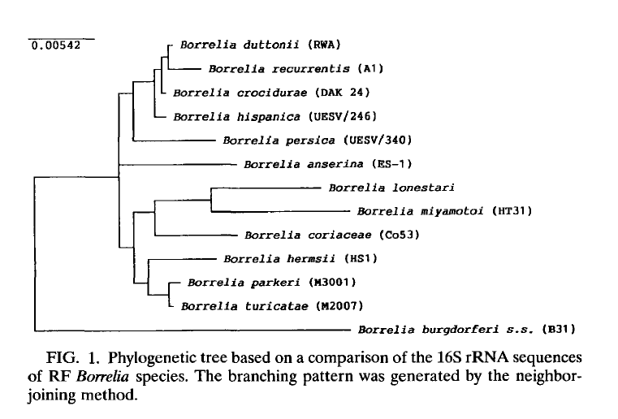
Borrelia – relapsing fever group 1996
SERONEGATIVE
on tests using
Borrelia burgdorferi
sensu lato (3 old)
as test antigen ..
However human patients in Russia with
B. miyamotoi infection were detected by cross-reaction in Euroimmun’s ELISA!
Ras et al. Int J Syst Bacteriol. 1996 Oct;46(4):859-65.1996 Oct;46(4):859-65.

Slide 29
RELAPSING FEVER BORRELIA spp.
Phylogenesis of relapsing fever Borrelia spp. (1996)
http://www.ncbi.nlm.nih.gov/pubmed/8863409 (free full text)
Borrelia crocidurae – Africa, soft ticks Ornithodorus
Borrelia duttoni, Africa, soft ticks Ornithodoros moubata
Borrelia hermsii - USA
Borrelia hispanica
Borrelia parkeri – USA
Other ….
Borrelia miyamotoi
Japan (1995), USA (tick 2001, human 2013) Sweden (tick 2002, 2010) Russia human 2011), Slovakia (tick 2012) Estonia (tick 2012) .. Europe
Japan tick 1995: http://www.ncbi.nlm.nih.gov/pubmed/8586277
“We have cloned and sequenced the flagellin gene from Borrelia miyamotoi strain HT31 and compared it with previously published flagellin sequences.
Sequence similarity analysis demonstrated that strain HT31 is phylogenetically distant from the three species of Lyme disease borreliae …”
USA tick 2001: http://www.ncbi.nlm.nih.gov/pubmed/12653133
”Infected ticks are POSITIVE for Borrelia spp. by DFA test
NEGATIVE for Borrelia burgdorferi by polymerase chain reaction (PCR) using species-specific primers for 16S rDNA, outer surface protein A, outer surface protein C, and flagellin genes.”!

Slide 30
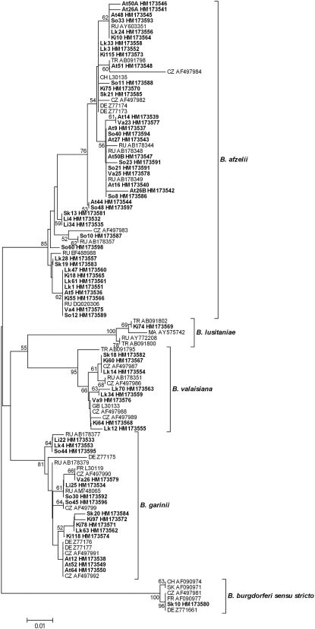

Borrelia – Lyme (Bbsl)
2010 Sweden
2010 Prevalence and diversity of Borrelia species in ticks that have bitten humans in Sweden.
Wilhelmsson et al.
J Clin Microbiol. 2010 Nov;48(11):4169-76. PMC

Slide 31
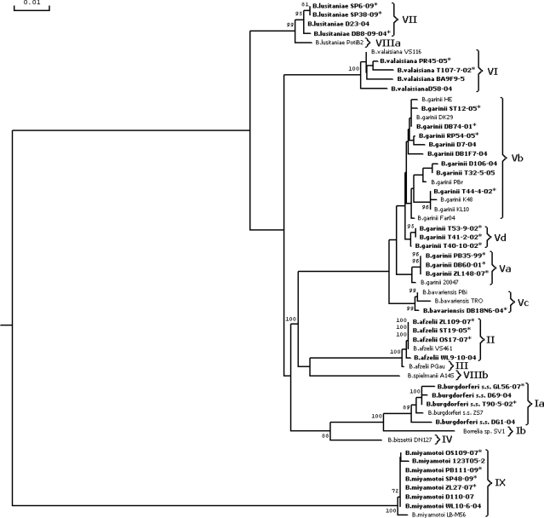
Borrelia b.s.l. Europe
2011
flaB gene as a molecular marker
for distinct identification of Borrelia species in environmental samples
by the PCR-restriction fragment length polymorphism method.
Wodecka B.
Appl Environ Microbiol. 2011 Oct;77(19):7088-92. PMC

Slide 32
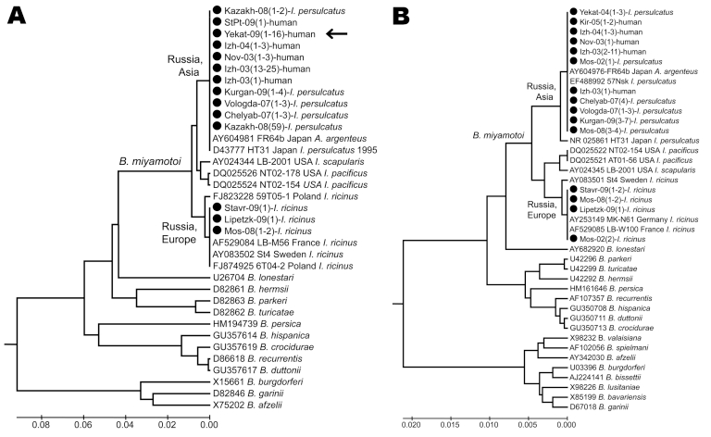


flaA
16S RNA
2011 Platonov et al. Humans Infected with Relapsing Fever Spirochete Borrelia miyamotoi, Russia.
Emerg Infect Dis. 2011 October; 17(10): 1816–1823. PMC
Fig.3 Phylogenetic tree of Borrelia spp. detected in persons and ticks, based on flagellin gene fragment (A) and 16S rRNA gene fragment (B).

Slide 33
Borrelia burgdorferi gene flux & exchange ..
2000 A bacterial genome in flux: the twelve linear and nine circular extra chromosomal DNAs in an infectious isolate of the Lyme disease spirochete Borrelia burgdorferi.
Casjens S et al. Mol Microbiol. 2000 Feb;35(3):490-516. PDF
  21 extra chromosomal DNA elements, 12 linear and 9 circular plasmids = total 610 694 bp.
  Analysis of the sequence implies that there has been extensive and sometimes rather recent DNA rearrangement among a number of the linear plasmids. Many of these events appear to have been mediated by recombinational processes that formed duplications.
  These rearrangements appear to have contributed to a surprisingly large number of apparently non-functional pseudogenes, a very unusual feature for a prokaryotic genome.
  The large majority, over 90%, of genes on these plasmids have no convincing similarity to genes outside Borrelia, suggesting that they perform specialized functions.
2009 Intergenic regions of Borrelia plasmids contain phylogenetically conserved RNA secondary structure motifs.
Delihas N. BMC Genomics. 2009 Mar 6;10:101. PMC
  These regions have many fragmented genes, repeated sequences and appear to be in a state of flux, but they may serve as reservoirs for evolutionary change and/or maintain stable motifs such as small RNA genes.
  Five repeat sequences were found that could fold into stable RNA-type stem loop structures, three of which are closely linked to protein genes, one of which is a member of the Borrelia lipoprotein_1 super family genes and another is the complement regulator-acquiring surface protein_1 (CRASP-1) f
  The cell may conserve these RNA motifs whereas allow a large flux in amino acid sequence, possibly to create new virulence factors but with associated RNA motifs intact.

Slide 34
BIOFILM – Borrelia does this too!
BIOFILM community = planktonic (free, single) microbes fix themselves to a surface (wound, endothel, synovia, endocardium) – then begin forming colonies consisting of and protecting the interior of colony by dead debris and slime …
2012 Borrelia burgdorferi biofilm - Sapi in vitro study:
” The atomic force microscopic results provided evidence that multilevel rearrangements take place at different stages of aggregate development, producing a complex, continuously rearranging structure. Our results also demonstrated that Borrelia burgdorferi is capable of developing aggregates on different abiotic and biotic substrates, and is also capable of forming floating aggregates. … In summary, we have found substantial evidence that Borrelia burgdorferi is capable of forming biofilm in vitro. Biofilm formation by Borrelia species might play an important role in their survival in diverse environmental conditions by providing refuge to individual cells.”
BRAIN: “In the 3 AD cases, cortical atrophy, dissemination of microorganisms in the cerebral cortex in the form of scattered circumscribed colonies, and distribution of beta amyloid deposits were morphologically similar to previously described pathological changes in dementia paralytica [19,24,39] caused by Treponema pallidum (Fig. 4). Thread-like structures disseminated in the cortical neuropil, compatible with individual spirochetes, were also observed.

Slide 35
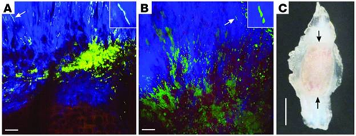
BIOFILM …
2004 Miklossy PDF In vivo BRAIN Alzheimer plagues probably is Borrelia in biofilm
An immunohistochemical analysis was performed for the detection of Borrelia burgdorferi antigens in the brain of the patients from which Borrelia spirochetes were cultivated. Western blot analysis of 8 different antibodies showed their ability to recognize Borrelia burgdorferi antigens (Fig. 3).
The colony-like masses and part of the disseminated individual filaments showed positive immunoreactions with anti-Borrelia burgdorferi antibodies (Fig. 5(B)), including the anti-OspA antibody. … stronger in the center of the colony- or plaque-like structures. … antigens, including OspA were also detected in a number of neurofibrillary tangles (Fig. 5 (D,E)) and in the wall of some blood vessels containing amyloid deposition (Fig. 5(F)). On serial sections, Borrelia antigens, bacterial peptidoglycan and Aβ were co-localized in senile plaques and in blood vessels. Borrelia burgdorferi OspA and flagellin genes were also detected in senile plaques and in a number of neurofibrillary tangles in all three AD cases by in situ hybridization (ISH) (Fig. 5(H)). The pattern of distribution was similar to Borrelia antigens.
2008 Rudenko HEART – Borrelia bissettii ENDOCARDITIS is biofilm PMC
Molecular analysis of a clinical sample confirmed the presence of Borrelia bissettii DNA in cardiac valve tissue from a patient with endocarditis and aortic valve stenosis. This evidence strongly supports the involvement of B. bissettii in Lyme disease in Europe.
2012 Bockenstedt Joint (mice) PMC ----------------->
See also Alan MacDonald’s website:
http://alzheimerborreliosis.net
– lots of magnificent IMAGES of BIOFILM
and many from neuropathology, autopsy material etc.

Slide 36
Bacterial conjugation – genetic transfer
= transfer of genetic material between bacterial cells by direct cell-to-cell contact or by a bridge-like connection between two cells ~ horizontal cell to cell transfer of PLASMID genes. … Living close together in biofilm colonies, must facilitate the exchange of genetic material:
PubMed search: Borreli*+conjugation borreli*+transfer+(gene+OR+plasmid)
1991 Linear plasmids of Borrelia burgdorferi have a telomeric structure and sequence similar to those of a eukaryotic virus.
Hinnebusch. J Bacteriol. 1991 November; 173(22): 7233–7239. PMC
….. These findings suggest that the novel linear plasmids of Borrelia originated through a horizontal genetic transfer across kingdoms.
1995 Evidence for lateral transfer and recombination in OspC variation in Lyme disease Borrelia.
Livey I et al. Mol Microbiol. 1995 Oct;18(2):257-69. PMID: 8709845
….. Evidence indicates that recombination occurs between ospC genes from the same Borrelia species (i.e. B. afzelii and B. garinii) as well as between different Borrelia species (i.e. B. afzelii and B. garinii, B. burgdorferi and genogroup DN127).
1999 Evidence for frequent OspC gene transfer between Borrelia valaisiana sp. nov. and other Lyme disease spirochetes.
Wang G et al. FEMS Microbiol Lett. 1999 Aug 15;177(2):289-96. PMID: 10474195
... our findings indicate that ospC gene transfer occurs between B. valaisiana and other Lyme disease spirochetes.
2003 Intra- and interbacterial genetic exchange of Lyme disease spirochete erp genes generates sequence identity amidst diversity.
Stevenson B ett.al. J Mol Evol. 2003 Sep;57(3):309-24. PMID: 14629041
… These studies also found the first evidence of large-scale genetic exchanges between Lyme disease spirochetes in nature, including the apparent transfer of an entire cp32 plasmid between two different bacteria.
2004 Genetic exchange and plasmid transfers in Borrelia burgdorferi sensu stricto revealed by three-way genome comparisons and multilocus sequence typing. Qiu WG et al. Proc Natl Acad Sci U S A. 2004 Sep 28;101(39):14150-5. PMC
Comparative genomics of closely related bacterial isolates is a powerful method for uncovering virulence and other important genome elements. ... We conclude that B. burgdorferi undergoes genome-wide genetic exchange, including plasmid transfers, and previous reports of its clonality are artifacts from the use of geographically and ecological isolated samples. Frequent recombination implies a potential for rapid adaptive evolution and a possible polygenic basis of B. burgdorferi pathogenicity.
2007 Evidence of a conjugal erythromycin resistance element in the Lyme disease spirochete Borrelia burgdorferi.
Jackson CR et al. Int J Antimicrob Agents. 2007 Dec;30(6):496-504. PMC
… An intergeneric conjugal system in B. burgdorferi suggests that horizontal gene transfer may play a role in its evolution and is a potential tool for developing new genetic systems to study the pathogenesis of Lyme disease.
2011 Evidence of direct cell-cell fusion in Borrelia by cryogenic electron tomography.
Kudryashev M et al. Cell Microbiol. 2011 May;13(5):731-41. doi: 10.1111/j.1462-5822.2011.01571.x. PMID: 21276171
… these spirochetes can associate with each other during movement. Using cryo-electron tomography, we observed closely associated Borrelia cells. Some of these showed a single outer membrane surrounding two longitudinally arranged cytoplasmic cylinders. We also observed fusion of two cytoplasmic cylinders and differences in the surface layer density of fused spirochetes. These processes could play a role in the interaction of Borrelia species with the host's immune system.

Slide 37
PCR multilocus sequence typing (MLST)
- and analysis of outer surface protein C gene (ospC) alleles.
Investigation of genotypes of Borrelia burgdorferi in Ixodes scapularis ticks collected during surveillance in Canada.
Ogden et al.
Appl Environ Microbiol. 2011 May;77(10):3244-54. doi: 10.1128/AEM.02636-10. PMID: 21421790
The genetic diversity of Borrelia burgdorferi sensu stricto, the agent of Lyme disease in North America, has consequences for the performance of serological diagnostic tests and disease severity.
309 infected adult Ixodes scapularis ticks
6 Borrelia miyamotoi
1 Borrelia kurtenbachii
142 B. burgdorferi sequence types (STs) described from the United States
58 B. burgdorferi of 1 of 19 novel or undescribed STs, which were single-, double-, or triple-locus variants of STs first described in the United States.
Seventeen ospC alleles were identified in 309 B. burgdorferi-infected ticks.
Geographic analysis of STs and ospC alleles were consistent with south-to-north dispersion of infected ticks from U.S. sources on migratory birds.
With all this variability and exchange

Slide 38
Sick from infection with any BORRELIA spp.
= BORRELIOSIS, is more than Lyme disease!
POINT: Great diversity, antigenic variation, master of disguise, nearly perfect parasites, multiple hosts, the BORRELIA family survives all …
Since 1992 and PCR => ever enlarging numbers of sub-spp. found – they are differentiated by:
Genes =>
Surface antigens (some highly variable, Vmp, VlsE) =>
Antibodies raised against Borreliae vary and change over the disease course!
SO - can ONE serology test, with ONE antigen, from ONE sub-spp.
DETECT ALL BORRELIA sub-SPP. Equally well? – that is very unlikely
- as it was pointed out by Felsenfeld already back in 1971!
And with the genetic variance / flux / conjugation we may not rely on PCRs that only search for single genes (ospA for instance may be absent) in patient strain?
HUMAN cases infected with ”new” types: B. lusitaniae & B. valaisiana (BTW both found in danish ticks) had no detectable antibodies in serum measured by serology test with antigens from 3 old European Borrelia burgdorferi sensu lato strains
- despite they had MUCH longer BORRELIOSIS disease duration than 3 months (10 years)!
B. Miyamotoi (Russia 46 pt. ) were Euroimmun IgM+ some also turned IgG+ in 2 weeks!
IgM is less specific than IgG, may catch Borrelia infectios BROADER?
- many chronic patients I see, have only had IgM, not IgG in serum – which STRAINS?

Slide 39
My personal HISTORY:
1984/01 grad. as cand. med. from Odense / South Danish University. Worked since as a MD in many CLINICAL MEDICINE hospital dep., gaining BROAD CLINICAL EXPERIENCE, hereof a total of 8 years in different PEDIATRIC dept.
1988 saw in OUH pediatric department the first patient diagnosed there with “typical” Lyme borreliosis - a girl with facial palsy
1992-93 worked in the PATHOLOGY dep. at OUH, as I needed a job without night nor weekend duties, after giving birth in Dec. 1991.
I did a lot of autopsies and microscopies, saw that clinicians diagnoses were not always correct; the most common error was venous leg thrombosis in a bedridden, leading to death by pulmonary emboli, where the breathing problems were misjudged and treated as pneumonia, despite it is a common cause of death for bedridden. Infectious disease department hardly ever let their dead be autopsied, apparently not interested in being caught in doing errors? .. The worst miss of all was an old native Danish lady, who died from widespread caseous necrosis of TUBERCULOSIS all over her abdomen, was misjudged as cancer via scan. She probably had acquired her tuberculosis as child/young, but the infection had been contained for decennials, until she got myelomatosis, hence immune depression, allowing the previously “encapsulated TB” to flourish. NOBODY had THOUGHT OF IT! - AUTOPSY IS IMPORTANT as we can learn a lot from it.
1994 my special interest in Borrelia started with seeing some children, that were breaking at least one of the many dogmatic LYME B. “rules”, each. 1996/03 held staff meeting lecture on topic “10 children with ‘ATYPICAL’ borreliosis” - One SERONEG. LATE NLB!
3/10 had sub-acute MONOARTHRITIS, 9/10 complained about joint/muscle aches, ON-OFF (=relapses!), 1 EM after 4h tick-bite ..
One with splenomegaly needed retreatment. No further clinical relapses during 2 year follow up after 2nd treatment with 6 weeks oral antibiotic.
1995 Antibodies against whole sonicated Borrelia burgdorferi spirochetes, 41-kilodalton flagellin, and P39 protein in patients with PCR- or culture-proven late Lyme borreliosis. Oksi J et al. J Clin Microbiol. 1995 Sep;33(9):2260-4. PMID: 7494012 PMC
- i.e. our DANISH FLAGEL ELISA antibody test - IDEIA (DAKO>Oxoid) - had FAILED to detect LATE (> 3 months borreliosis) by direct test verified ACTIVE Borrelia infection in 6/12 culture + and 18/29 PCR+ => 24/41= 58.5% FALSE SERONEGATIVE cases
& 7/41 (17%) had NO Bb-ANTIBODIES on either of 3 serology tests compared in the study!
SO I had already had a couple of years to read up on the subject of Borreliae - incl. Joe Burrascano’s guidelines - and was well aware of the diversity / controversy and problems with infection detection by (ELISA) serology methods!- especially because of this – when I got …
1996/08 a maculo-papular, nearly confluent “atypical” rash on my right buttock, which enlarged to hand-large in 3 weeks, then faded away; I was on holiday, no GP visit, no treatment; 6 weeks later RADICULITIS with extreme pain in L5-S1 dxt. Area + muscle cramps, could not sit, but for a few minutes! – at first I was treated with physiotherapy for suspected disc prolapse, until scan revealed I had no lumbar disc prolapse; a borderline Borrelia IgM+ was dismissed as false positive, because I did not turn IgG+; I was instead diagnosed with hypermobility; despite I told the doctor about the rash, it is not even mentioned in my medical record! … since 1999/09 SICK PENSION; I could not manage in pediatrics, with risk of creating life-lasting consequences for children, if I did wrong, being always so sick, tired, in pain, bad concentration, bad short term memory etc., 1998-99 I tried to shift MD specialty from PEDIATRICS to PEDIATRIC PSYCHIATRY, but big relapse stopped that.

Slide 40
SICK, but denied both treatment & direct test for Borreliae by OUH!
1998 my IgM was clear positive, still no IgG! – “for the benefit of the doubt” I got ceftriaxone 2g / die IV for 1 month + clarithromycin 500mg x 2 for 11 weeks, felt normal for the first time in 2 years! - but prof. told me to stop treatment and I was compliant - but relapsed shortly after stopping treatment - the professor said:
”We will not give you more antibiotic treatment unless you can PROVE you are still infected with BORRELIA”!
=> START OF MY PERSONAL QUEST and RESEARCH
… 1999 got great help by Lyme.org - Karen V. Forschner “Everything you need to know about Lyme disease” and J Clin Tickborne Dis (JSTD) reprint FELSENFELD in spring and summer ed. …
… 1998 Brorson finding “cysts” could revert back to spirochete form etc. etc.
– thinking:
“How would I become able to find proof for still having Borrelia infection, when my danish colleagues refused to do any direct test methods for Borrelia?” … well, MICROSCOPY is ENOUGH to make the diagnosis of syphilis in case SPIROCHETES are detected, I had seen some in the venereal clinic!
”AGENTS TRANSMITTED BY BLOODSUCKERS MUST BE PRESENT IN THE BLOOD”
.. But probably not in spirochete form for more than 1 day per relapse? - like it was found for all the relapsing fever Borreliae? .. SPIROCHETEs only enters BLOOD during ACTIVE RELAPSE episode(s)!
”Could I perhaps find similar” as Balfour 1911 (I found that paper in 1999) … Hindle 1912
- and many, many others who studied SPIROCHETES via the microscope 100+ years ago?
“When serology test fails and a reliable PCR is not available, what else can I do (for few money) to try to find SPIROCHETEs in BLOOD?”
  The LOGICAL answer:
  I must find the OPTIMAL TIME during CLINICAL RELAPSE – when SPIROCHETES enter BLOOD – and then time my MICROSCOPY to that short period!
  Doing SYMPTOMDIARY can show RELAPSING DISEASE PATTERN and COST NO MONEY!
  MY DIARY 2000: had 2 overlapping curves (under Tx for Borrelia): 3-4 weeks interval possibly related to BORRELIA , plus another curve cycling at 4-5 days interval => I MUST HAVE MIXED INFECTION!

Slide 41
A research lab in Florida, USA, worked on direct immuno-stain for Borrelia and offered examination of blood smear for co-infection …
  => 2001/03 (after pause with antibiotics for 2 months allowing worsening of Borrelia) send samples to USA, sampled during start of new active BORRELIA CYCLE:
  Positive result for Borrelia burgdorferi antigen on DFA + ringforms in several RBC (max. 1%) + morula-like inclusion in a MONOCYTE; my smear findings were confirmed by
  1. reference lab. In the USA
  2. by myself, and later
  3. DVM Tarello, Italy
  – I and Tarello looked at concurrent smear as those to BRT and on several serial smears taking in the weeks after!
  => On the pictures from BRT of phase contrast plus DF and DFA with KPLs. Bbsl specific FITC-Borrelia antibody stain - I could see similar structures, as what I had already seen in autumn 2000 as
  MOVING GRANULES inside cell-like structures, some with nucleus, some without. I noticed that there were many “granulated cellular structures” when I felt sick and there were very few on my better days, where blood could look normal.
  OTHER PATIENTs WANTED BRTs TEST TOO, but it had to be done as science, prospective and with Tarello doing “blind” control i.e. without knowing if person was sick or healthy, not knowing if BRT or I had found anything, for triple comparison. We could both agree with BRT on all positive for ringforms, more problems with something inside WBC. DIRECT BORRELIA IMMUNOSTAIN, smear microscopy.
  2001-6: 50/50 chronic patients pos. on Borrelia-DFA! - ca. 2/3 had sign of MIXED INFECTION; ca. 1/3 had RINGFORMS in RBC; <10 (some uncertain) had morulae-like inclusions in RBC; 2 Bartonella like org.
  – many had larger darker “granules” in WBC (as shed by spirochetes) corresponding to those seen on relatively moving (take a look of some video from blood microscopy). Presented findings in UK conferences: York 2003, York 2004, Leicester 2007.
  In 2002 we created DanInfekt, our patient organization; our aim is to support the sick, inform and raise money for and do research; bought Paralens epi-flourescence and incubator (I borrow), DanInfekt members is an ideal group to do research on, if we could raise enough money; it is possible to buy BSK-H (6% rabbit serum, Sigma) and rather expensive Bb-antibodies from KPL; I did successful CULTURE and immune stain trial in 2010, however my cheap USB camera was not light sensible enough to take photos of a few green “micro-snakes from Hell”, and granules on black background, and was giving raster (despite 3 Mpixel it was not better than my old VGA cam, Bresser cam can not work under C64. .
  We just (march) invested personally, in a brand NEW MICROSCOPE AND CAMERA – so I look forward to continue my MICROSCOPY studies of SPIROCHETES - BACK TO BASICS ;)

Slide 42
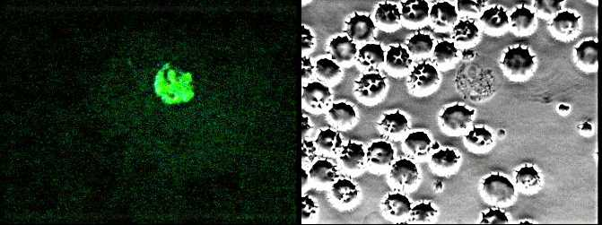
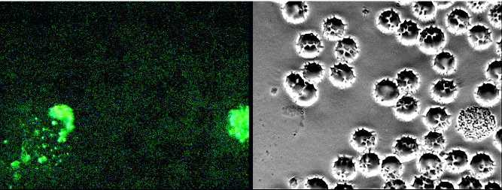
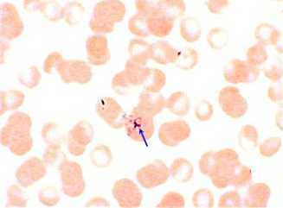
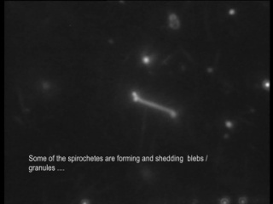
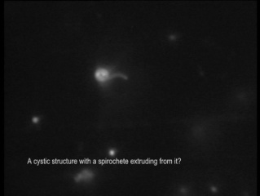
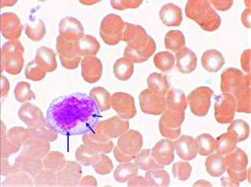
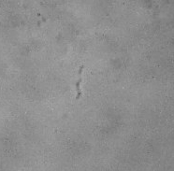
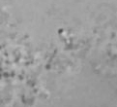
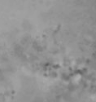
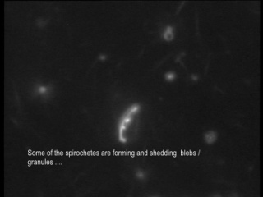
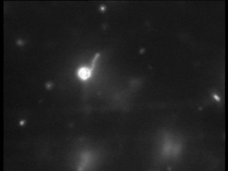
My PROOF for still being infected with Borrelia?
– is still not ENOUGH for OUH to offer treatment!
  2001: Positive DFA for B. burgdorferi
  2008: 0001-20081016
  – videomicroscopy by dr. Bela Bozsik (snapshots from the video I showed you earlier):
  2001 + ringforms and morulae-like inclusion in MONOCYTE - both confirmed by a USA reference lab AND in both concurrent and later serial smears, similar was also detectable by myself & DVM Tarello, Italy!
2010: 0001-20100302
Culture BSK-H, 4 weeks => SPIROCHETES (see still photos below)
Plus LOTS of ”GRANULES” (most lie still, others are tumbling, just like they do in blood) and apparently growing in BIOFILM-like colonies ..
2009 I asked ID colleagues in OUH
– both the professor who denied me treatment after positive DFA in 2001, and the current “expert”! – and showing them Bozsik’s dark-field microscopy
THEY DO NOT FIND ANY VISIBLE SPIROCHETES BY MICROSCOPY IN BLOOD ENOUGH REASON TO TREAT (they do not time to relapse and concentrate sample, can not re-find!) – therefore I must continue my search for even BETTER PROOF - next step must be attempt PCR , trying to subtype strain
which strains DO sick Danes have?
Thanks for your patience.
http://lymerick.net/videomicroscopy.htm
http://lymerick.net/MK-videomicroscopy.html

Slide 43
THANK YOU VERY MUCH
for your attention!
Hope you were not all too bored,
and perhaps learned a bit OLD NEWS
- even better if you got INSPIRED
- to try MICROSCOPY?
  My presentation will be put on http://LymeRICK.net
  LymeRICK = Lyme and Related Infections Centre of Knowledge
  Site for my literature database, that help me remember where I read what!
  Embedded links within this presentation will direct you to open relevant references
  - so you can read it all, learn and enjoy som very GOOD BASIC SCIENCE
  ☺

